Slide 1

Advanced course
Lesson 12
Advanced course（4）
Chameleon
YahBoom Croco:Kit tutorial

Slide 2
Advanced course
Content
Part1
Part 2
Part3
Part 4
Part 5
Learning goals
Preparation
Connection
Search for blocks
Combine blocks
YahBoom Croco:Kit tutorial

Slide 3
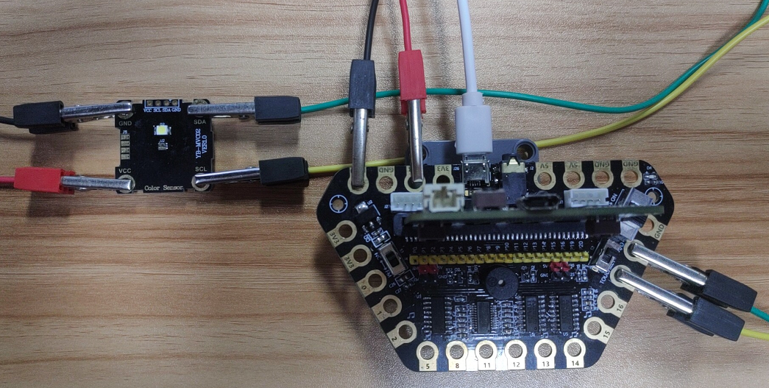
Advanced course
Part 1
Learning goals
After downloading the program, we can see the word 'HELLO!' on the Micro:bit LED dot matrix. When the color sensor detects red, the LED dot matrix will display “R”, when the color sensor detects green, the LED dot matrix will display “G”, when the color sensor detects blue, the LED dot matrix will display “B”.
YahBoom Croco:Kit tutorial

Slide 4
Advanced course
Part 2
Hardware:
● 1 X Micro: bit Board
● 1 X Micro USB Cable
● 1 X Diamond breakout
● 1 X Color recognition module
● 4 X Alligator clip
● 1 X PC
Preparation
Mode 1 online programming: First, we need to connect the micro:bit to the computer by USB cable. The computer will pop up a USB flash drive and click on the URL in the USB flash drive: http://microbit.org/ to enter the programming interface. Add the Yahboom package: https://github.com/lzty634158/Croco-Kit to program.
Mode 2 offline programming: We need to open the offline programming software. After the installation is complete, enter the programming interface, click【New Project】, add Yahboom package: https://github.com/lzty634158/Croco-Kit , you can program.
YahBoom Croco:Kit tutorial

Slide 5
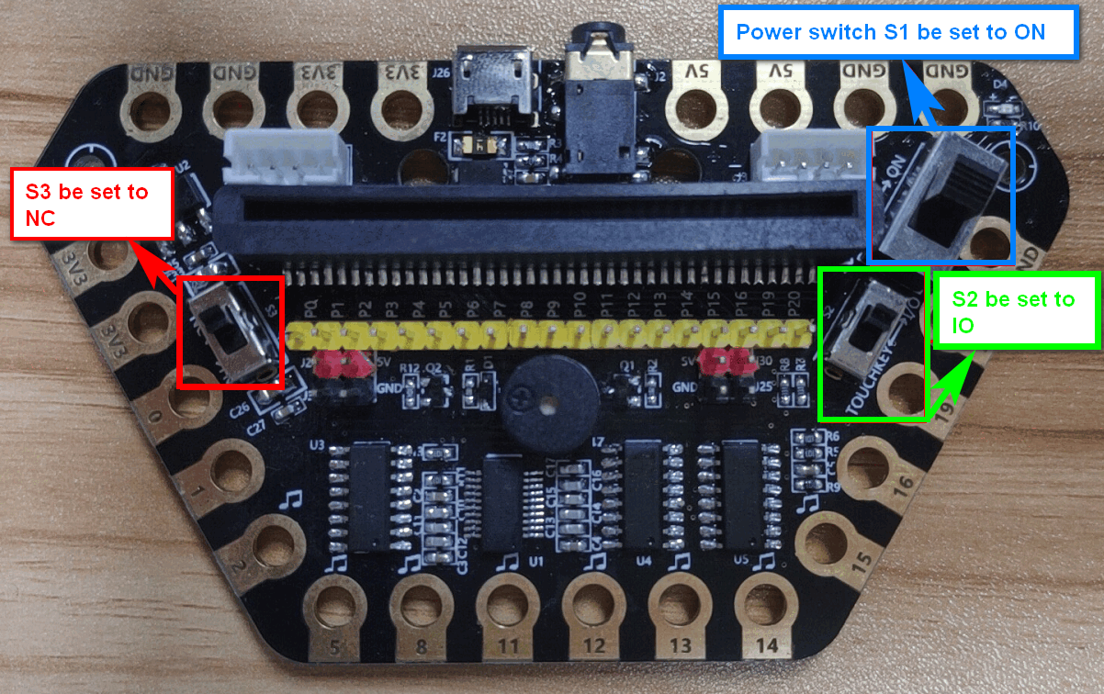
Advanced course
Part 2
Preparation
! ! !Note: S1 be set to the ON, S2 be set to the IO, and S3 to the NC.
YahBoom Croco:Kit tutorial

Slide 6
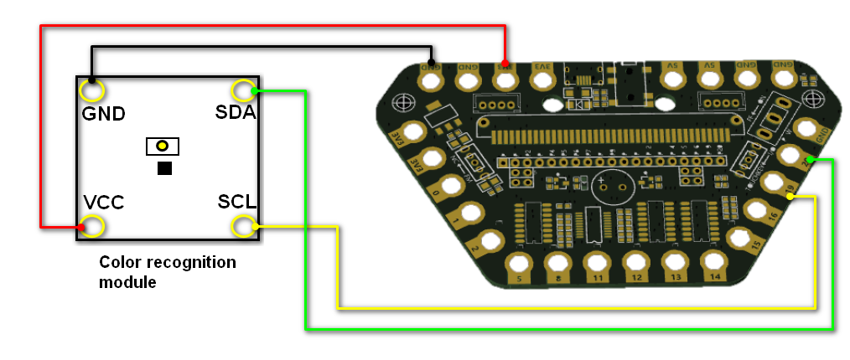
Advanced course
Part 3
Expansion board | Color recognition module
P19 | SCL
P20 | SDA
3.3V | VCC
GND | GND
Connection
YahBoom Croco:Kit tutorial

Slide 7
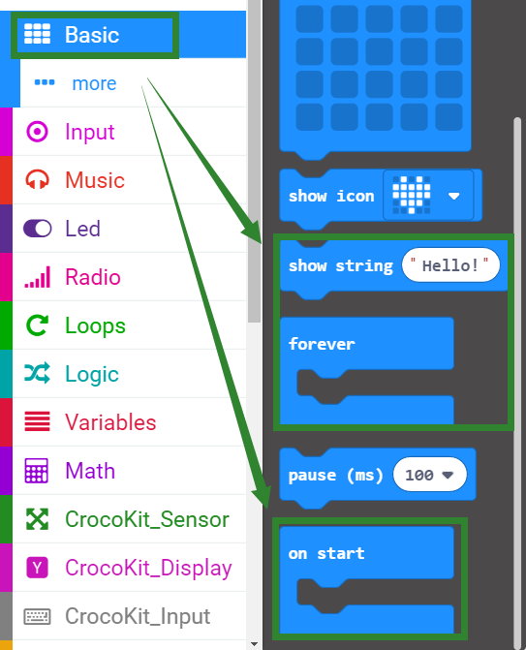
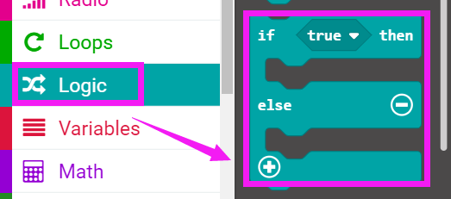
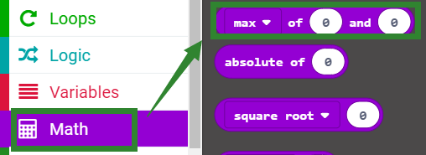
Advanced course
Part 4
Search for blocks
YahBoom Croco:Kit tutorial

Slide 8
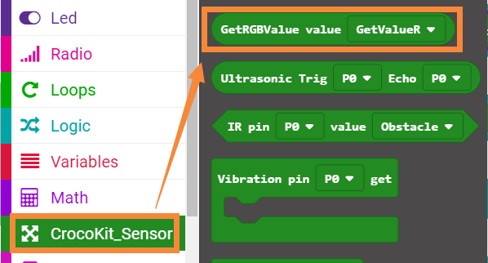
Advanced course
Part 4
Search for blocks
YahBoom Croco:Kit tutorial

Slide 9
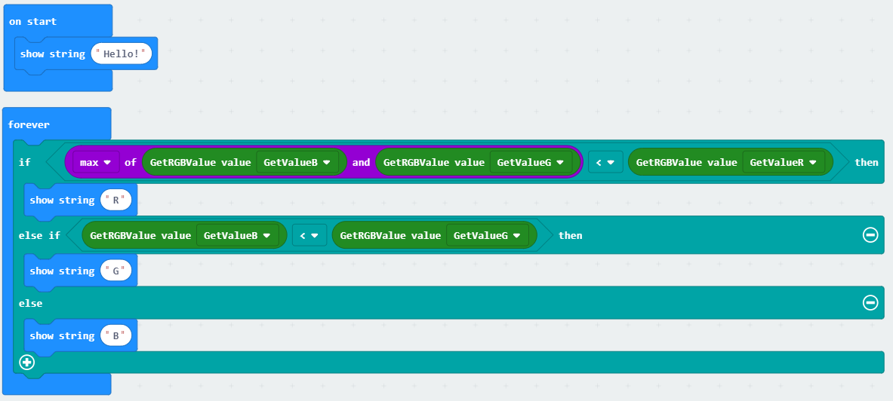
Advanced course
Part 5
Combine blocks
YahBoom Croco:Kit tutorial

Slide 10
Advanced course
Thank you ！
Powered by YahBoom
YahBoom Croco:Kit tutorial

